Slide 1

Unsupervised Learning

Slide 2
Outline
Clustering
Introduction
Different Types of Clustering
Kmeans Clustering
Case Study
Technical Support Data Clustering
Retail Customers

Slide 3
We all generate tremendous amount of data
. . .
Unlabeled Data

Slide 4
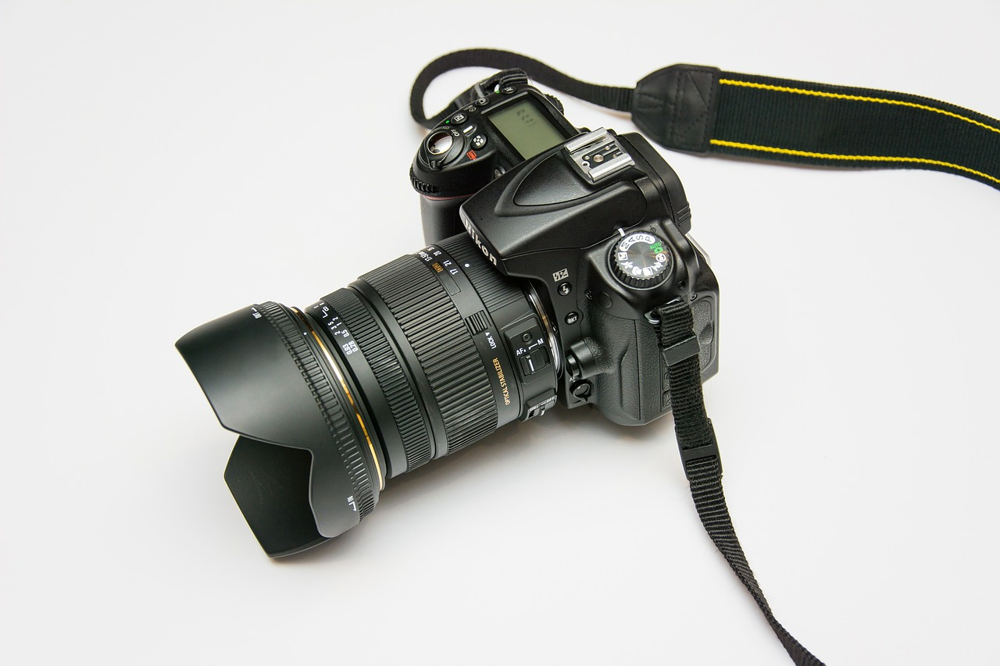



Photos
Social Media
Patient Data
Survey Data

Slide 5
How do we make sense of Unlabeled Data

Slide 6

Label the Data

Slide 7
Very Expensive
Lacks new Learnings

Slide 8
How to learn from Unlabeled Data?

Slide 9
Clustering

Slide 10
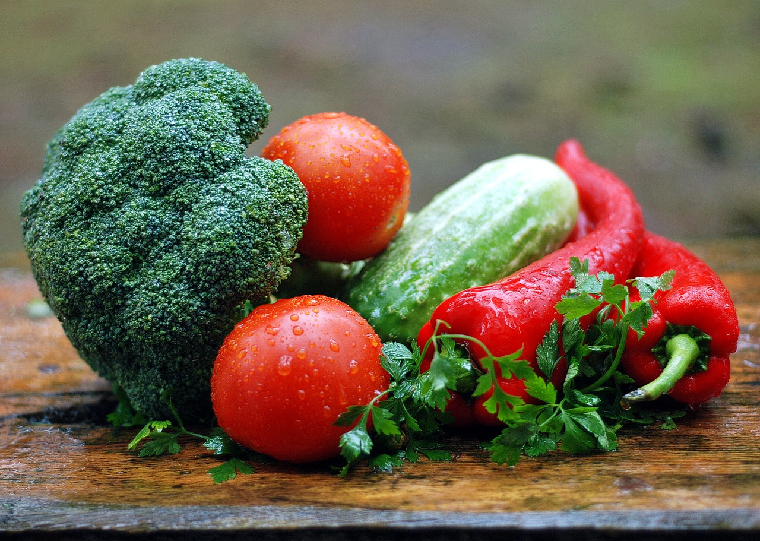
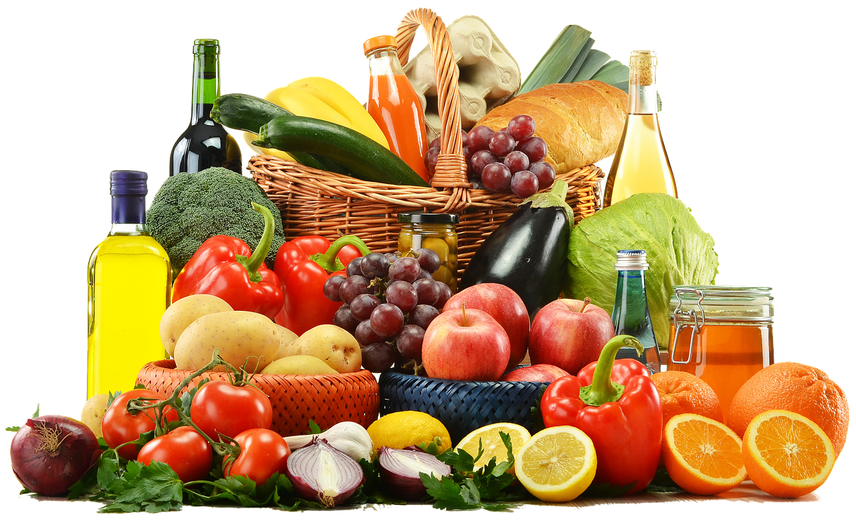
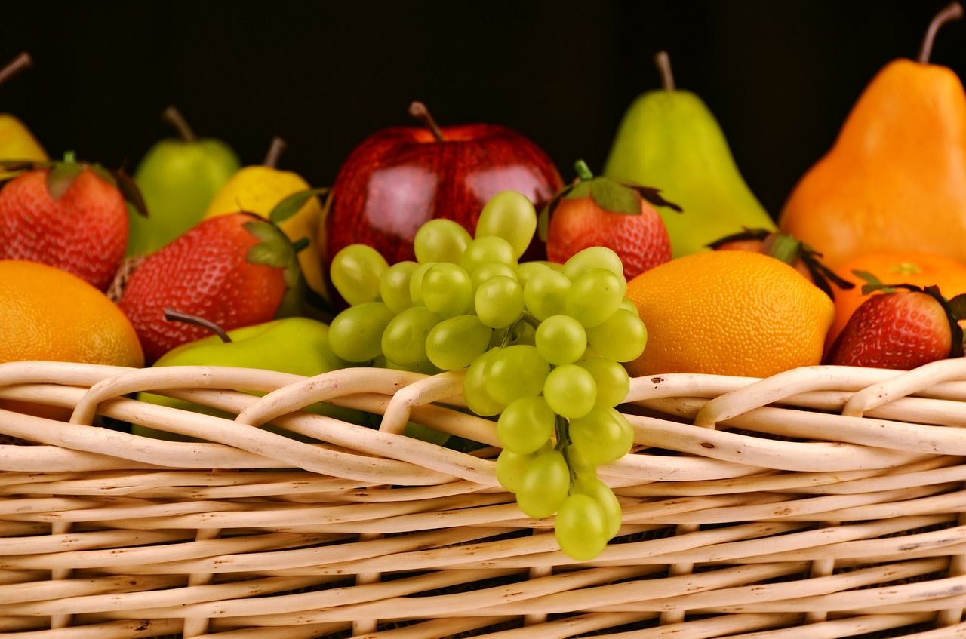
Cluster #1
Unlabeled Data
Cluster #2

Slide 11
Vegetables
Unlabeled Data
Fruits

Slide 12
Clustering
Grouping of Similar things

Slide 13
Clustering
No concept of training or test set

Slide 14
Clustering is primarily an exploratory technique to discover hidden structures of the data, possibly as a prelude to more focused analysis or decision processes
A way to decompose a data set into subsets with each subset representing a group with similar characteristics
When we cluster observations we seek to partition them into distinct groups such that objects in the same group are more similar to each other in some sense than to objects of different groups
The groups are known as clusters and each cluster gets distinct label called cluster id, the centroid of the cluster, and inertia
Clustering is often used as a lead-in to classification. Once the clusters are identified, labels can be applied to each cluster to classify each group based on its characteristics
Can also be used to decide whether there is a need for separate models representing each cluster (will be so if clusters are very different on the attributes), or a single model can be reliable. If separate models are required, will the attributes have equal importance
Clustering helps simplifying the data representation through the centroid methods.

Slide 15
Some Applications of Clustering
Some specific applications of k-means are image processing, medical, customer segmentation, finance
Image processing : used to cluster of pixels representing objects in each frame. The attributes of each pixel can include brightness, color, and location, the x and y coordinates in the frame. Successive frames are examined to identify any changes to the clusters. These newly identified clusters may indicate unauthorized access to a facility.
Medical : Patient attributes such as age, height, weight, systolic and diastolic blood pressures, cholesterol level, and other attributes can identify naturally occurring clusters under various health conditions
Customer segmentation : Cluster customers on basis of frequency of purchase, recency of purchase, value of purchase and look for common attributes among high value customers. Target all potential customers who have similar attributes
Trading

Slide 16
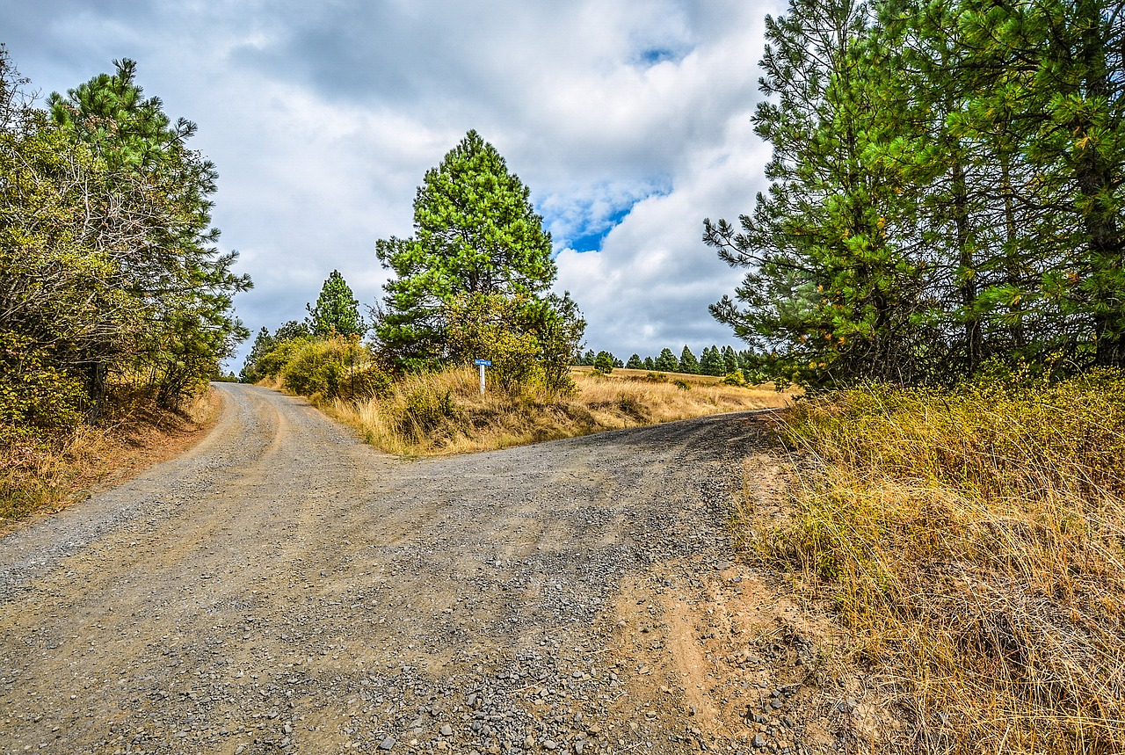
How to Cluster Unlabeled data

Slide 17
Clustering Types
Two broad categories of clustering include hierarchical (agglomerative, divisive) and non hierarchical
Hierarchical clustering
Agglomerative clustering algorithm uses a bottom-up approach and merges smaller clusters into larger ones
Divisive clustering uses top-bottom approach to break a large cluster into smaller clusters
Non-hierarchical / partitional clusters are formed on assumption that the clusters are disjoint and there is no hierarchical relation between them. K Means is an example

Slide 18
Hierarchical
Non Hierarchical

Slide 19
Hierarchical
Agglomerative
Divisive

Slide 20
Hierarchical
Agglomerative

Slide 21
Hierarchical
Divisive

Slide 22
Non
Hierarchical
K-Means

Slide 23
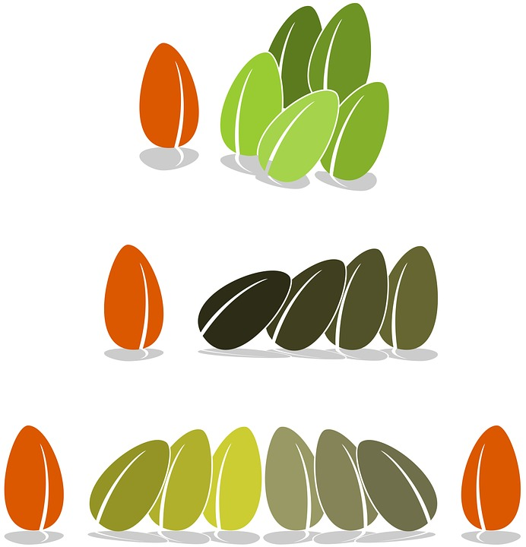
How do we find similar items?

Slide 24
Clustering – Distance Calculations
Irrespective of the clustering algorithm, we need a way of defining similarity/ dissimilarity
Central to all of the goals of cluster analysis is the notion of the degree of similarity (or dissimilarity) between objects being clustered
Clustering method attempts to group the objects based on the definition of similarity supplied to it. The definition uses distance calculation functions for the same
We also need a way to define and calculate distance between clusters of objects
The lesser the distance, more similar the objects are and more suited to form a larger cluster
There are many ways of calculating distance between two points i.e. if d = f(x,y) then there are many ways in which f can be implemented

Slide 25
d₃
d₄
d₅
d₂
d₁
Find distance between data points

Slide 26
D₁
Find distance between clusters

Slide 27
How to calculate distance using Math?

Slide 28
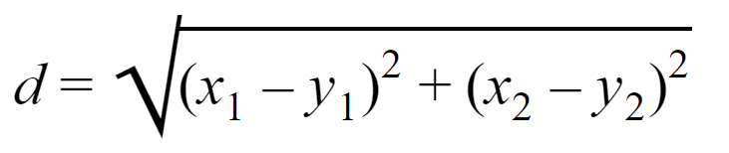
1. Euclidean Distance
(y₁ ,y₂)
Y
x
(x₁ ,x₂)

Slide 29
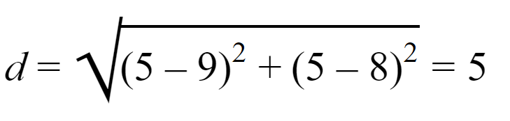
1. Euclidean Distance
(9 ,8)
Y
x
(5 ,5)

Slide 30
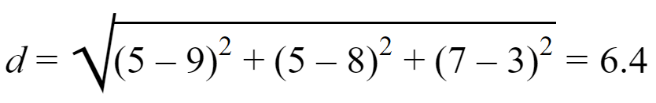
1. Euclidean Distance
(9 ,8,3)
Y
x
(5 ,5,7)
L2 Norm

Slide 31
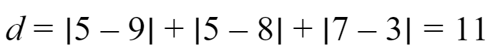
1. Euclidean Distance
(9 ,8,3)
Y
x
(5 ,5,7)
L1 Norm or
Manhattan distance

Slide 32
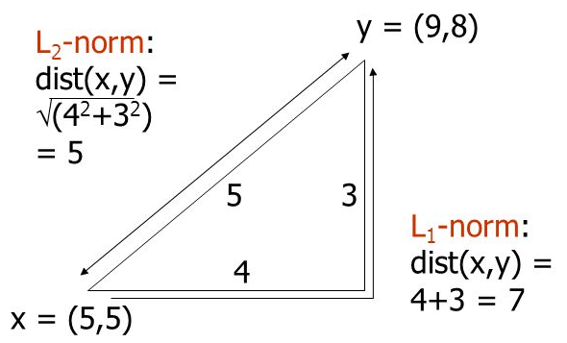
Clustering – Distance Calculations
Euclidean Distance
L2 norm : d(x,y) = square root of the sum of the squares of the differences between x and y in each dimension. The most common notion of “distance”. If there are two dimensions x and y, the distance between two points A and B is –
Manhattan / Taxi Distance
L1 norm : sum of the differences in each dimension. Manhattan distance = distance if you had to travel along coordinates only

Slide 33
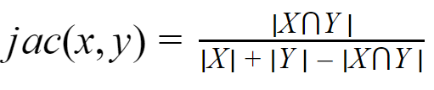
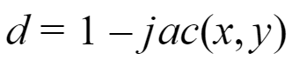
2. Jaccard Distance
Intersection
Union

Slide 34
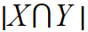
2. Jaccard Distance
X
Y

Slide 35
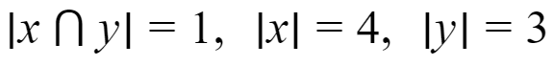
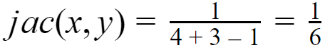
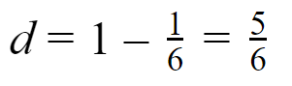
2. Jaccard Distance
X | 1 | 0 | 0 | 1 | 1 | 1
Y | 0 | 1 | 1 | 0 | 1 | 0

Slide 36
3. Cosine Distance
(530K, 2B)
(250K, 4B)
Prices
(230K, 5B)
θ₁
θ₂
Bedrooms

Slide 37
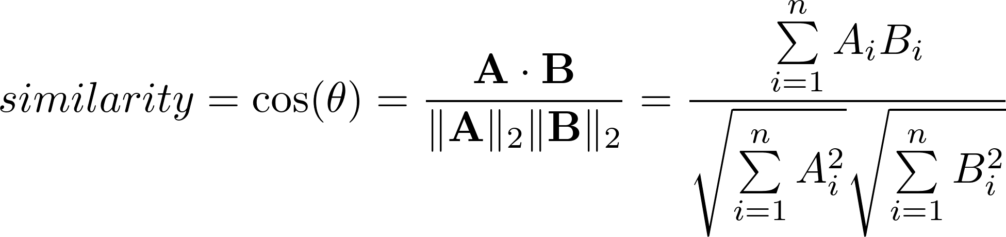
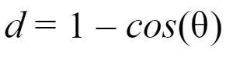
3. Cosine Distance
A
B
θ

Slide 38
4. Edit Distance
Given two vectors, find minimum number of operations to transform one vector into another.

Slide 39
4. Edit Distance
Kitten -> Sitting
Kitten -> Sitten
Sitten -> Sittin
Sittin -> Sitting
3 operations - substitution and addition

Slide 40
Clustering – Distance Calculations
Non Euclidean Distance
Jaccard distance for sets = 1 minus ratio of sizes of intersection and union.
Cosine distance = angle between vectors from the origin to the points in question.
Edit distance = number of inserts and deletes to change one string into another
Mahalanobis distance – takes into account the covariance between attributes (Ref: http://mccormickml.com/2014/07/22/mahalanobis-distance/ )
Euclidian Distance … Some points
The measures computed in Euclidian methods are highly influenced by the scale of each variable
Variables with larger scale have much greater influence over the total distance. This may or may not be good for clustering

Slide 41
Calculating distance between Clusters
D

Slide 42
1. Minimum Distance
(Single Linkage)
D

Slide 43
2. Maximum Distance
(Complete Linkage)
D

Slide 44
3. Average Distance
(Average Linkage)
D₂
D₁
(D₁ + D₂ )/2

Slide 45
4. Centroid Distance

Slide 46
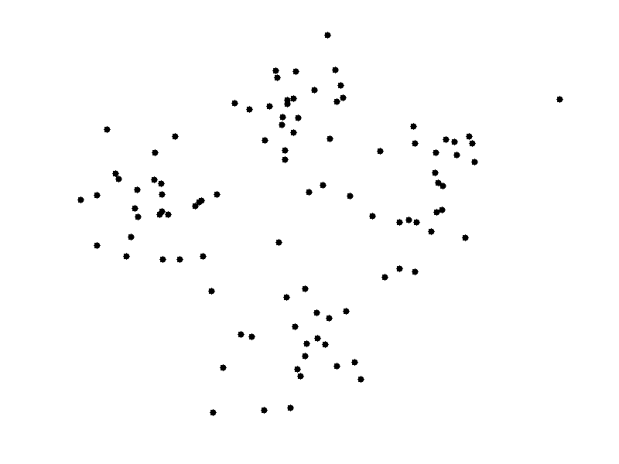
K-Means Clustering
Credit Andrey A. Shabalin

Slide 47
Define number of Clusters ‘K’

Slide 48
What will be center point for each Cluster i.e Centroid?

Slide 49
Randomly choose K data points

Slide 50
Randomly choose K data points

Slide 51
Assign each Data point to a Cluster

Slide 52
Assign each Data point to a Cluster

Slide 53
Repeat this for each point

Slide 54
Calculate Mean of Data points in Each Cluster

Slide 55
Move Centroid to Mean for each Cluster

Slide 56
Move Centroid to Mean for each Cluster

Slide 57
Calculate Distance to Centroid for each point

Slide 58
Reassign Each point to cluster

Slide 59
Calculate mean of Data points in a Cluster
Move Centroid
Calculate distance for each point from centroids
Reassign Data Points

Slide 60
..till data points stop changing Cluster

Slide 61
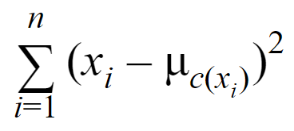
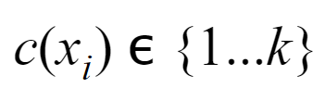
K-Means Goal
Minimize
Centroid

Slide 63
Prediction for a new Data point?
Check distance from Centroids

Slide 64
What should be value of ‘K’?

Slide 65
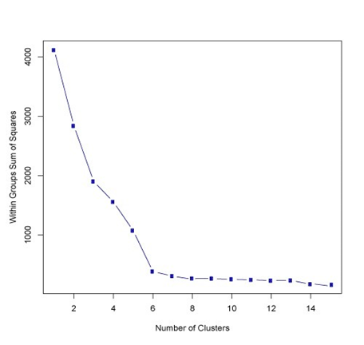
Elbow method

Slide 66
Given that the total variance T across the entire data set is a constant, T = BC + WC (T = between cluster variations (BC) and within cluster variance (WC)
Thus WC = T – BC
Minimizing WC = Maximizing BC. Thus the objective of clustering is to get tightest and farthest clusters. Achieving one will automatically get the other i.e. tightest will make the clusters farthest. In the process ensure the clusters are natural, meaningful
Unfortunately, there is no well defined algorithm to achieve this. The problem of finding the tightest and farthest clusters in a data set belongs to a family of problems called the NP Hard problems (Non deterministic, Polynomial-time Hard problems). Ref: http://jeffe.cs.illinois.edu/teaching/algorithms/notes/30-nphard.pdf
For this reason, the clustering algorithms usually converge to sub-optimal solutions or converge to local optima. However, they are still powerful techniques in highlighting hidden structures

Slide 67
Distance measures and some key points:
Choice of distance measures play a key role in cluster analysis
Knowledge of the distribution of data (gaussian or otherwise) will help
Are the various attributes independent or influence each other
Are their outliers in the data on the various dimensions
Though Euclidian distance is the most commonly used distance metric, it has three main features that should be kept in view
It is highly scale dependent. Changing the units of one variable can have a huge influence on the results. Hence standardizing the dimensions is a good practice
It completely ignores the relationship between measurements (Refer to Mahalanobis distance diagram)
It is sensitive to outliers. If the data has outliers that cannot be handled or removed, use of Manhattan distance is preferred
KMeans algorithm implements only Euclidian distance

Slide 68
Machine Learning (K Means Clustering – Some considerations )
K-Means (a.k.a Lloyd’s algorithm) clusters data by separating data points into groups of equal variance, minimizing a criterion known as the inertia or within-cluster sum-of-squared errors
It requires the number of clusters to be specified, hence the term “K” in its name
It divides the samples into K disjoint clusters Ci, each described by the mean of the samples in the cluster. The means are commonly called “centroids” (they are not the points from the data)
The K-Means algorithm chooses centroids that minimizes the within cluster inertia (variations) across all the clusters

Slide 69
Machine Learning (K Means Clustering – Some considerations )
From a computational perspective, the k-means algorithm is indifferent to the units of measure for a given attribute (for example, meters or centimeters for a patient's height). However, the algorithm will identify different clusters depending on the choice of the units of measure.
Choosing different starting points can result in different clusters. The algorithm is sensitive to the initial starting condition
Given enough time, K-means will always converge, however this may be a local minimum. This is highly dependent on the initialization of the centroids
Scikit-learn has implemented K-mean++ initialization scheme, which initializes centroids to be distant to one another which provably leads to better results

Slide 70
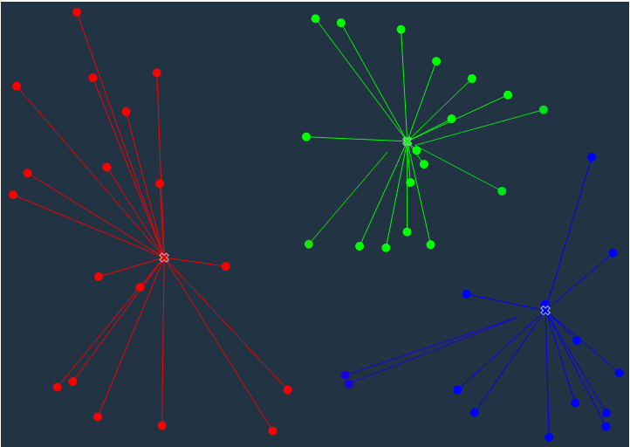
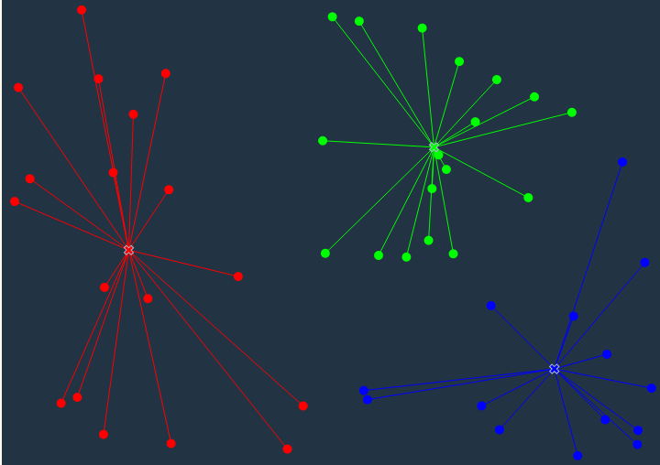
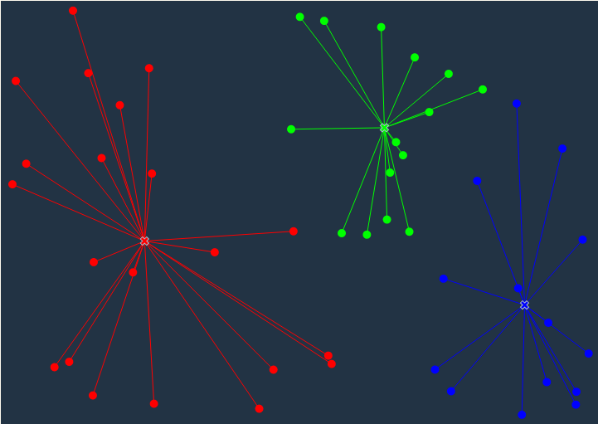
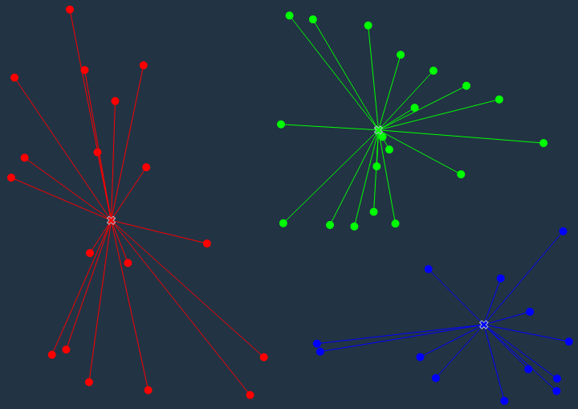
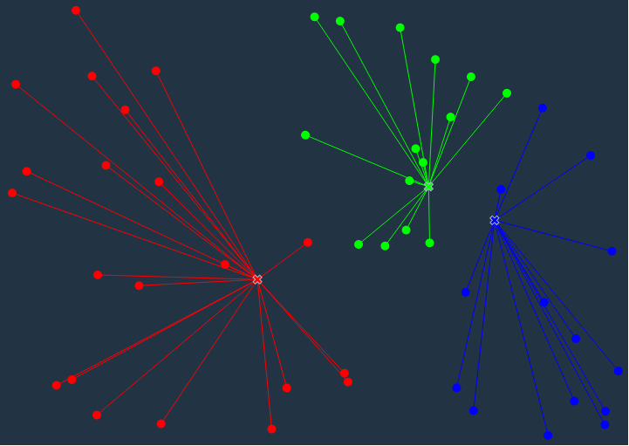
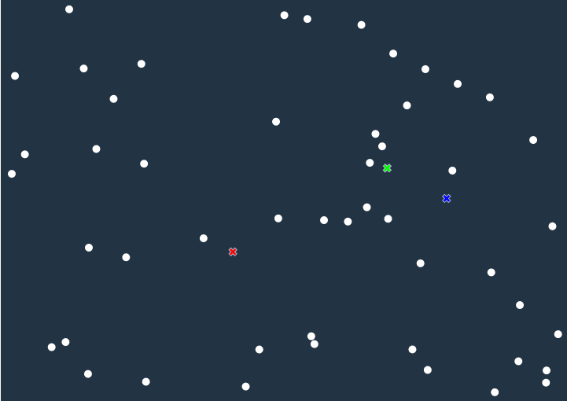
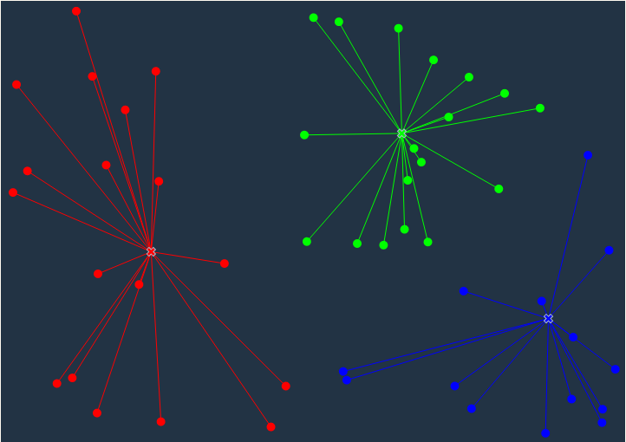
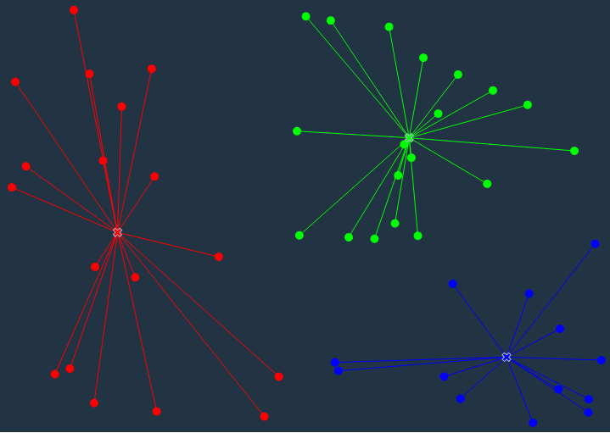
Machine Learning (K-means Clustering)
K-means treats feature values as coordinates in the multi-dimensional feature space
Calculate distance of the points from each of the three selected points. Link to the one closest
In the update phase the average position of each cluster is calculated (based on position of the points in the cluster)
Note : based on the distance of some boundary points from the new centroid, they get reallocated to different cluster
Since K = 3
Select 3 points at random from the data points
Ref: http://tech.nitoyon.com/en/blog/2013/11/07/k-means/

Slide 71
Machine Learning (K-means Clustering)
K Means Algorithm
Randomly pick K points in the feature space as initial centroids. Or randomly assign values 1 – K to each data point. This is the first version of K clusters. Obviously the worst clusters
Iterate until centroids stop moving or cluster assignment stops changing –
For each of the K clusters, compute the centroid i.e. avg on each attribute. The point in the mathematical space where these averages meet, is the new centroid. The Kth cluster centroid is thus a vector of P feature means for the observations in the Kth cluster
Re assign each data point to the centroid which is closest to them. Closeness is defined using Euclidian distance

Slide 72
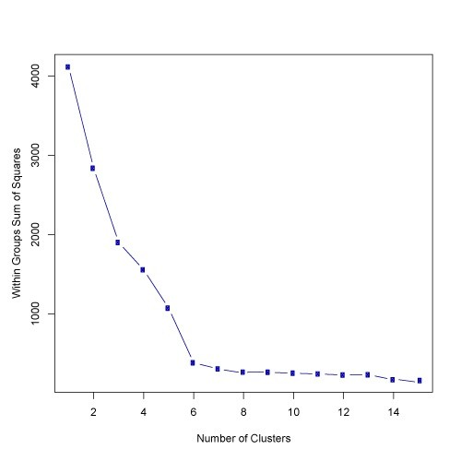
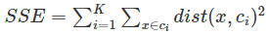
Machine Learning (K-means Clustering)
Without apriori knowledge, one can use elbow method that measures the homogeneity or heterogeneity within clusters as the number of clusters change (i.e. K is changed). One way to measure is use sum of square errors in each cluster

Slide 73
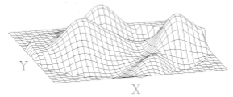
Machine Learning (K-means Clustering)
Visual Analysis for Clustering
Visual analysis of the attributes selected for the clustering may give an idea of the range of values that K should be evaluated in
Identifying the attributes on which clusters are clearly demarcated and using them in incremental order to build the multi-dimensional clusters likely to give much better clusters than using all the attributes at one go

Slide 74
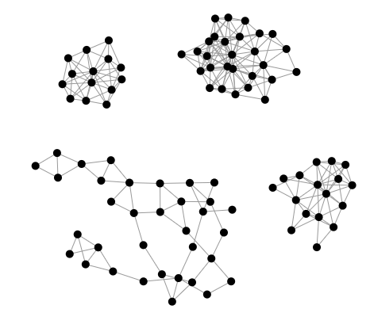


Silhouette Score
Poor clustering
( low SilScore and most points below Avg SilScore)
Cluster ids
SilScore
Avg SilScore
SilScore = B – A / max (A,B)
A = avg distance of a point from other points in its cluster
B = avg distance of a point from the points in the nearest cluster
Note: Every data point has a SilScore
Avg SilScore = sum of all SilScore / Number of data points

Slide 75


Optimal Clustering(high avg silscore and all clusters cross silscore)
Cluster ids
Avg SilScore
SilScore = B – A / max (A,B)
A = avg distance of a point from other points in its cluster
B = avg distance of a point from the points in the nearest cluster
Note: Every data point has a SilScore
Avg SilScore = sum of all SilScore / Number of data points

Slide 76
Machine Learning (K-means Clustering)
Dynamic Clustering
Clustering on correct attributes is the key to good clustering results.
We can also consider those attributes who's value changes with time. For e.g. age, income category, years of work experience etc.
We can use sequential k means clustering over time to track individual clusters (how they change in size, shape and position
We can also understand how individual data points move across clusters, form new clusters etc.
Analyzing the changes in the clusters over time using metrics such as
Cluster size, new entries and exits one can analyze the impact of strategies designed based on earlier clustering analysis

Slide 77
Machine Learning (K-Means Clustering)
Strengths | Weakness
Use simple principles without the need for any complex statistical terms | Computationally intensive How to fix K?
Once clusters and their associated centroids are identified, it is easy to assign new objects (for example, new customers) to a cluster based on the object's distance from the closest centroid | The k-means algorithm is sensitive to the starting positions of the initial centroid. Thus, it is important to rerun the k-means analysis several times for a particular value of k to ensure the cluster results provide the overall minimum WSS
Because the method is unsupervised, using k-means helps to eliminate subjectivity from the analysis. | Susceptible to curse of dimensionality

Slide 78

Technical Support Analysis with K-Means
Lab1_tech_supp_analysis.ipynb

Slide 79

Customer Segmentation
Lab2_HandsOn_Customer Segmentation using K-Means.ipynb

Slide 80
Context
In today’s competitive world, it is crucial to understand customer behavior and categorize customers to tailor promotional, marketing and product development strategies.

Slide 81
Divide customers into groups...
that share certain characteristics
Geographic regions
Demographics e.g age, gender, marital status, income etc
Psychographics e.g values, interests, lifestyle etc
Purchase behaviour e.g previous purchases, page views, shipping preferences etc
Can be difficult to do...
Almost infinite characteristics which can be used
No single, correct way

Slide 82
Online Retail Dataset
https://archive.ics.uci.edu/ml/datasets/Online+Retail

Slide 83
Goal
Identify High and Low Value Customers for marketing purposes

Slide 84
What will be our features?
Recency of the Purchase
Frequency of the Purchases
Monetary value of Purchases

Slide 85
Customer Segmentation using K-Means in Scikit-Learn

Slide 86
Questions?

Slide 87
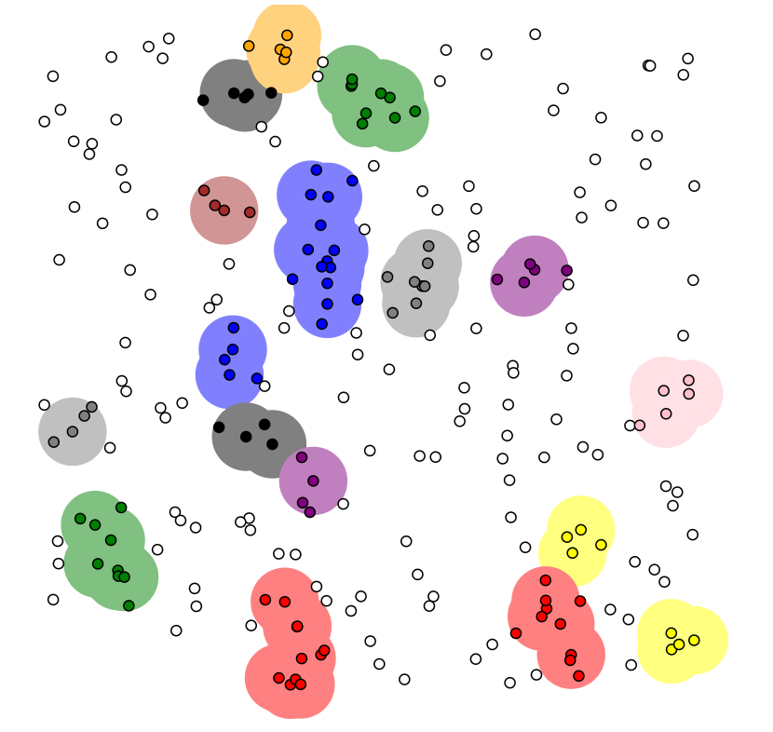
https://www.naftaliharris.com/blog/visualizing-dbscan-clustering/
DBSCAN
Density Based Spatial Clustering of Applications with Noise

Slide 88
How would K-Means Cluster these points?

Slide 89
Number of clusters decided by Data, unlike K-Means
Some data points may not be part of any Cluster
Views clusters as area of high density, separated by areas of low density
Uses two parameters to define density
min_samples
eps

Slide 90
How would DBSCAN Cluster the points?
Eps = 1
Min_samples = 4

Slide 91
2
How would DBSCAN Cluster the points?
Eps = 1
Min_samples = 4

Slide 92
2
Is this a Cluster?
Eps = 1
Min_samples = 4

Slide 93
2
Is this a Cluster?
Eps = 1
Min_samples = 4

Slide 94
2
Is this a Cluster?
Eps = 1
Min_samples = 4

Slide 95
Core Point
2
Is this a Cluster?
Yes
Border Point(s)
Eps = 1
Min_samples = 4

Slide 96
Core Point
2
Noise Point
Border Point(s)
Eps = 1
Min_samples = 4

Slide 97
For a data point, make n-dimensional sphere of radius ‘eps’
Count number of points in Sphere
Number of points in sphere > min_samples
Move to next point in Dataset
No
Yes
Expand Cluster by building sphere for each point in Cluster
Mark center of Sphere as part of Cluster

Slide 98
Visualizing DBSCAN
https://www.naftaliharris.com/blog/visualizing-dbscan-clustering/

Slide 99
Implementing DBSCAN

Slide 100
Strengths
No pre-defined K required
Can find arbitrary shaped clusters
Robust to outliers
Weakness
‘eps’ can be difficult to choose
May not work well with large differences in densities

Slide 101
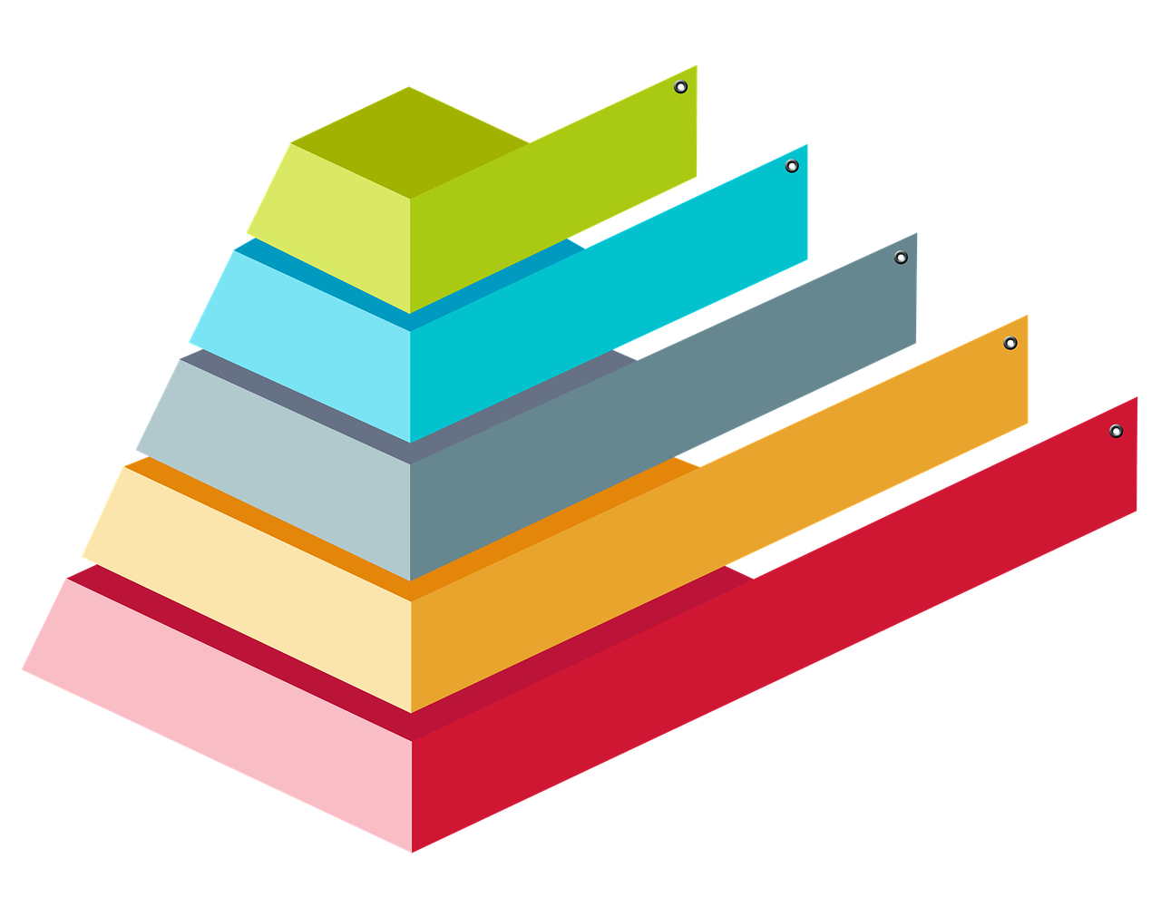
Hierarchical Clustering

Slide 102
Hierarchical
Agglomerative
Divisive

Slide 103
Hierarchical
Agglomerative
Bottom-Up approach
Start here

Slide 104
Hierarchical
Divisive
Start here
Top Down approach

Slide 105
Agglomerative Clustering

Slide 106
(3.2, 2.5)
(1.2, 2)
Each point is a Cluster
(4, 1.5)
(1, 1)
(2.5, 0)

Slide 107
(3.2, 2.5)
(1.2, 2)
2.06
1.28
Calculate Distance between Each Cluster
2.84
1.02
(4, 1.5)
(1, 1)
3.04
2.12
1.80
(2.5, 0)

Slide 108
(3.2, 2.5)
(1.2, 2)
Join nearest Clusters
(4, 1.5)
(1, 1)
(2.5, 0)

Slide 109
(3.2, 2.5)
(1.2, 2)
Find Centroid of new Cluster
(1.1, 1.5)
(4, 1.5)
(1, 1)
(2.5, 0)

Slide 110
(3.2, 2.5)
(1.2, 2)
Join Clusters
(1.1, 1.5)
(4, 1.5)
(1, 1)
(2.5, 0)

Slide 111
(3.2, 2.5)
(1.2, 2)
(3.6, 2.0)
Identify Centroid
(1.1, 1.5)
(4, 1.5)
(1, 1)
(2.5, 0)

Slide 112
(3.2, 2.5)
(1.2, 2)
(3.6, 2.0)
2.55
Measure Distance between Clusters
(1.1, 1.5)
(4, 1.5)
(1, 1)
2.15
2.28
(2.5, 0)

Slide 113
(3.2, 2.5)
(1.2, 2)
(3.6, 2.0)
Identify Centroid
(4, 1.5)
(1, 1)
(2.5, 0)

Slide 114
(3.2, 2.5)
(1.2, 2)
(3.6, 2.0)
Identify Centroid
(4, 1.5)
(1, 1)
(1.6, 1.5)
(2.5, 0)

Slide 115
(3.2, 2.5)
(1.2, 2)
Join Clusters
(4, 1.5)
(1, 1)
(2.5, 0)
Dendrogram

Slide 116
Machine Learning (Hierarchical (Agglomerative ) Clustering)
The agglomerative clustering starts with each cluster comprising exactly one data point in the feature space
It progressively agglomerates / combines the two nearest clusters until there is one grand cluster left in the feature space
For the closest cluster analysis, each of the inter cluster distance measurement techniques (single link, complete link, average link, centroid distance) can be implemented
In single linkage method, the minimum distance between nearest points from the two clusters is used to consolidate clusters
In complete linkage, distance between two farthest points from each cluster is considered
Group average clustering is based on the average distance between clusters
Prior domain knowledge helps in deciding the inter cluster distance metric selection. If the clusters are likely to be in long chain or sausage like, minimum distance (single linkage) would be a good choice
Complete and average linkage are better choice if the clusters are likely to be spherical

Slide 117
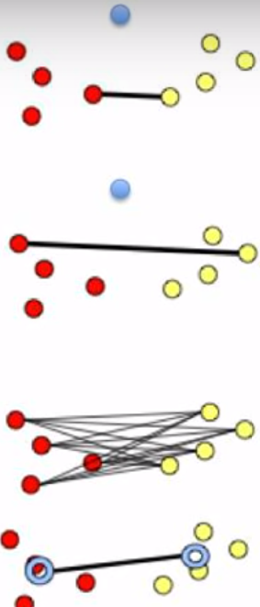
Machine Learning (Clustering – Measuring distance between clusters)
Ideally, a good clustering should result in compact clusters separated from one another by maximal distance. This calls for measuring the distance between cluster. The most widely used methods include :
Minimum distance(single linkage) – is the distance between pair of records Ai and Bj that belong to clusters A and B respectively and are closest
Maximum distance(complete linkage) – is the largest distance between the pair of records Ai and Bj that belong to cluster A and B respectively
Average distance (average linkage) - average distance of all possible distances between records in one cluster to records in other cluster
Centroid distance - the distance between centroids of the different clusters.
Distance between clusters is used in hierarchical clustering

Slide 118
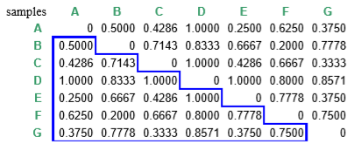
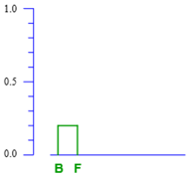
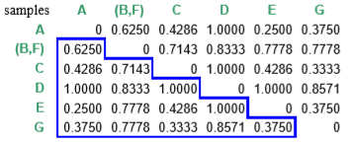
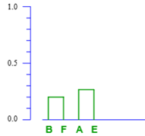
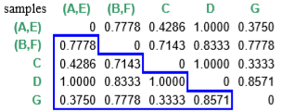
Complete Linkage

Slide 119
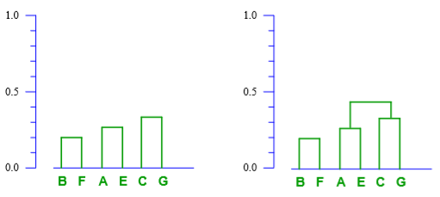
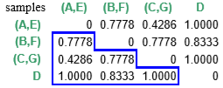

Slide 120
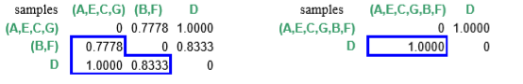
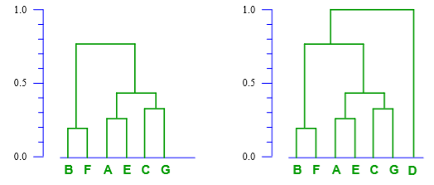

Slide 121
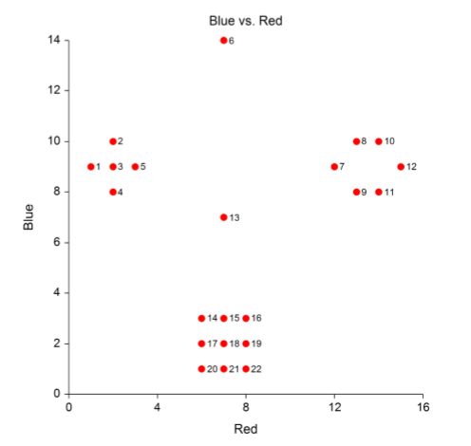
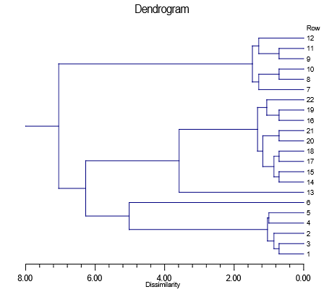
Machine Learning (Hierarchical (Agglomerative ) Clustering)
Dendrogram is a tree like diagram that summarizes the process of clustering. At the leaf are the records representing the data points while root node is the entire data. The intermediate nodes have two daughter nodes representing sub groups
Similar records are joined by lines who’s vertical length reflects the relative distance between the data points
When viewed bottom up, the tree posses a monotonicity property. Dissimilarity between the merged clusters is monotone increasing with the level of merger
Source: https://ncss-wpengine.netdna-ssl.com/wp-content/themes/ncss/pdf/Procedures/NCSS/Hierarchical_Clustering-Dendrograms.pdf

Slide 122
Machine Learning (Hierarchical (Agglomerative ) Clustering)
The horizontal axis of the dendrogram represents the distance or dissimilarity between clusters (the scale is in reverse order)
The vertical axis represents the objects and clusters.
Each fusion of two clusters is represented on the graph by the splitting of a horizontal line
The horizontal position of the split, shown by the short vertical bar, gives the distance (dissimilarity) between the two clusters
When we draw a vertical at any point on the X axis, the number of lines it cuts indicates number of clusters at that value of dissimilarity
2 clusters
3 clusters
5 clusters
Distance/ dissimilarity between 1,3 is less than between 4 and 5. This is reflected in the length of the horizontal bar which is longer for 4,5 compared to 1,3
Source: https://ncss-wpengine.netdna-ssl.com/wp-content/themes/ncss/pdf/Procedures/NCSS/Hierarchical_Clustering-Dendrograms.pdf

Slide 123
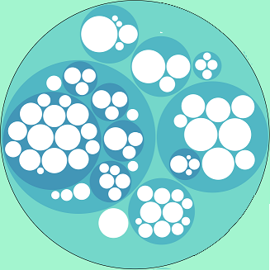
Clusters within clusters

Slide 124
How many Clusters to have?

Slide 125
Questions?

